Slide 1
CAPSTONE SQL DATA ANALYSIS PROJECT
-ANIKET CHOWDHURY

Slide 2
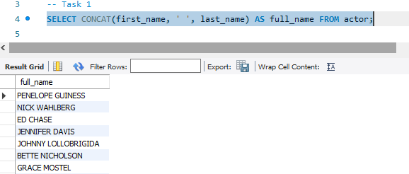
CODE & OUTPUT
INTERPRETATION
Outputs a list of actors with their first and last names concatenated, showing their full names. Used to demonstrate concatenating columns into a single output column.

Slide 3
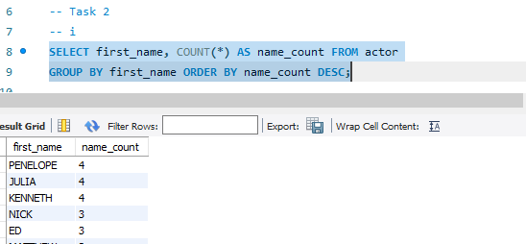
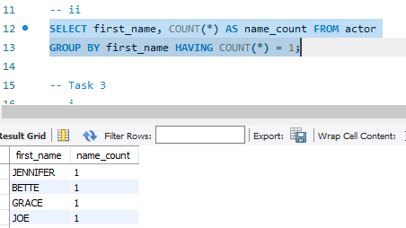
CODE & OUTPUT
INTERPRETATION
Counts number of actors with each first name, ordered by descending count. Shows which first names are most common among the actors. Also finds first names that only occur once (unique names).

Slide 4
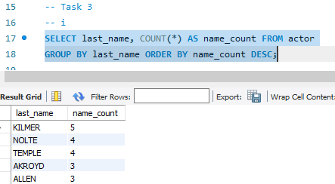
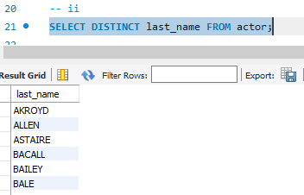
CODE & OUTPUT
INTERPRETATION
Same analysis as Task 2 but for last names.
Finds most common last names and unique last names.

Slide 5
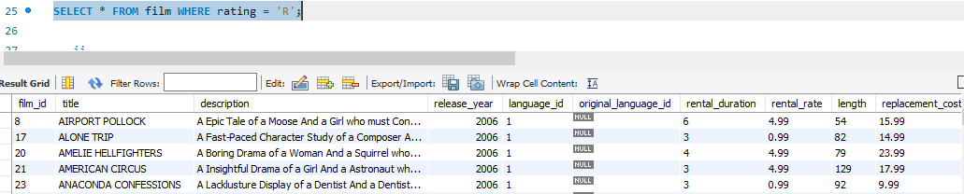
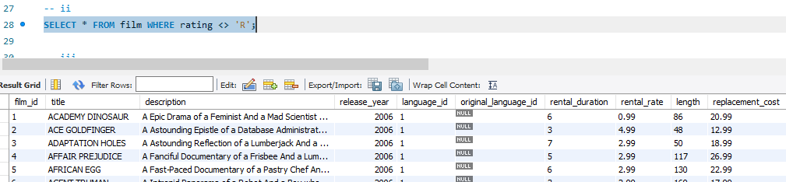
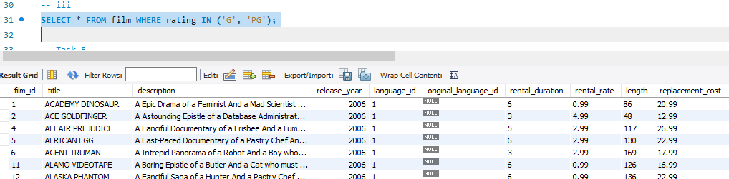
CODE & OUTPUT
INTERPRETATION
Finds all films with 'R' rating. Finds all films that do not have an 'R' rating. Finds films that are rated 'G' or 'PG'. Filters films based on rating.

Slide 6
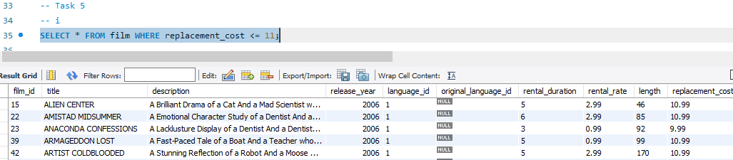
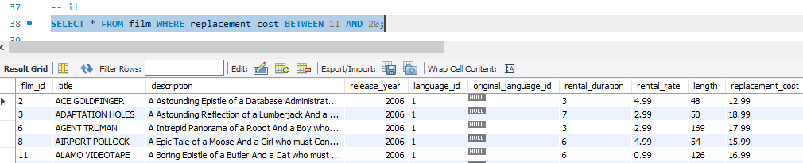
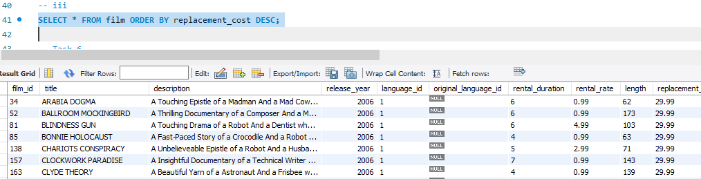
CODE & OUTPUT
INTERPRETATION
Finds inexpensive films, costing less than $11. Finds films in $11-$20 price range. Orders films by decreasing cost.

Slide 7
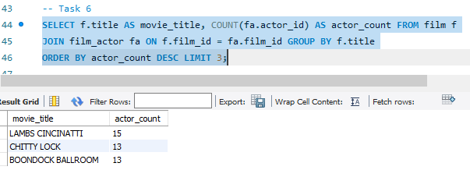
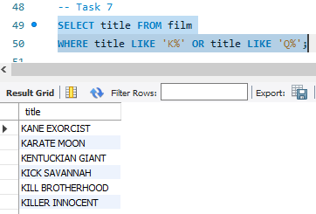
CODE & OUTPUT
INTERPRETATION
Finds top 3 films with most actors. Joins film and film_actor table to connect films and actors.
Finds films starting with 'K' or 'Q' using LIKE operator.

Slide 8
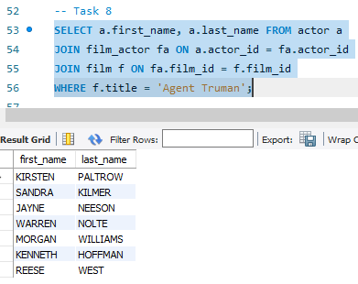
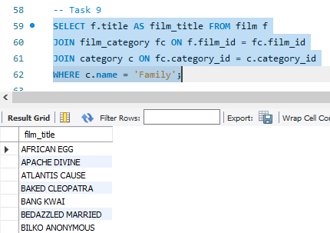
CODE & OUTPUT
INTERPRETATION
Finds actors who acted in film 'Agent Truman'. Joins tables to connect films to actors.
Finds family genre films by joining category table.

Slide 9
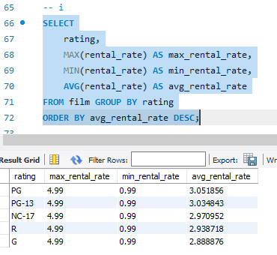
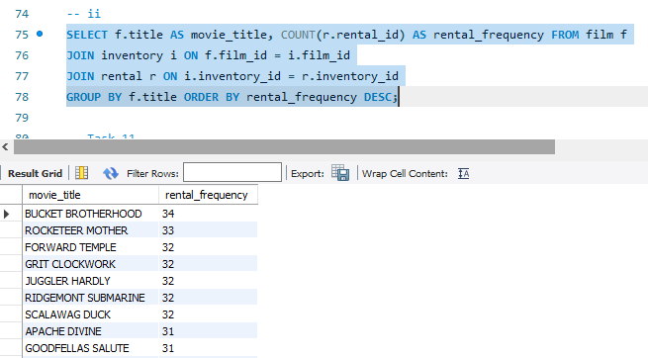
CODE & OUTPUT
INTERPRETATION
Analyzes rental rate by rating - max, min, avg.
Finds most frequently rented films.

Slide 10
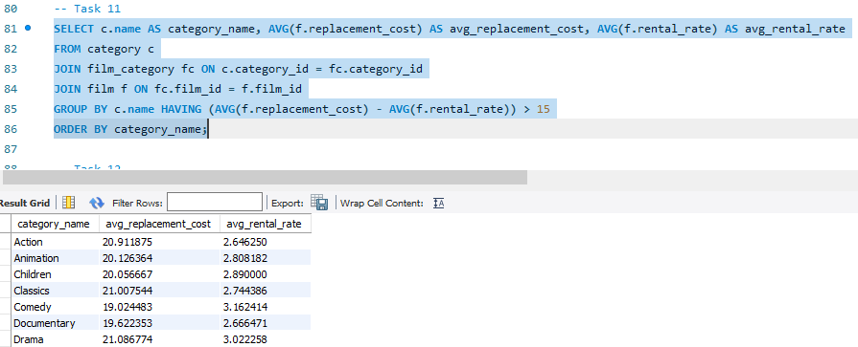
CODE & OUTPUT
INTERPRETATION
Compares replacement cost and rental rate by category.

Slide 11
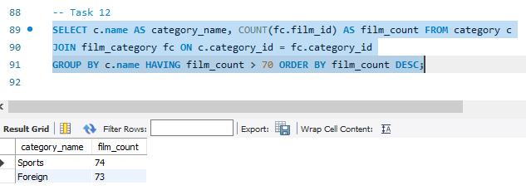
CODE & OUTPUT
INTERPRETATION
Finds categories with more than 70 films.

Slide 12
THANK YOU

